Slide 1
Improving Photo Retrieval in a User’s Browser History
Maria Tobin
Advisors: Aaron Cass and Chris Fernandes

Slide 2
Motivation
Back button is inefficient
History list is never used
Faster to perform an online search again than to search locally (Milic-Frayling et al. 2004)
Tools need to be improved!
Examples…

Slide 3
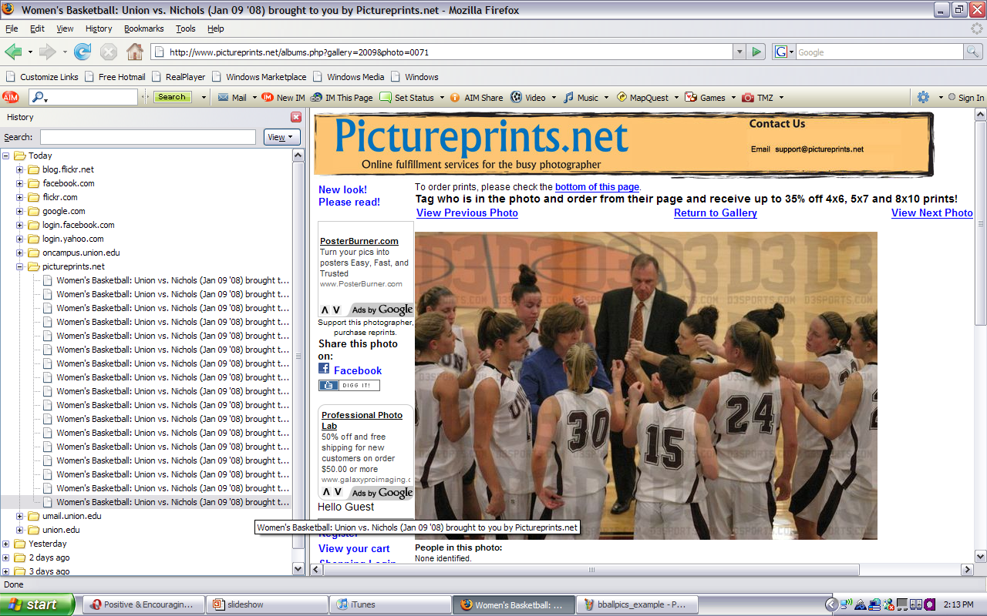
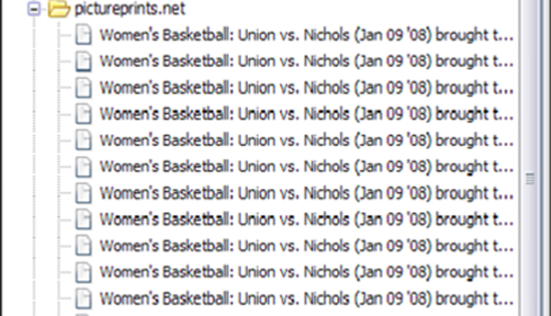
Items have identical names

Slide 4
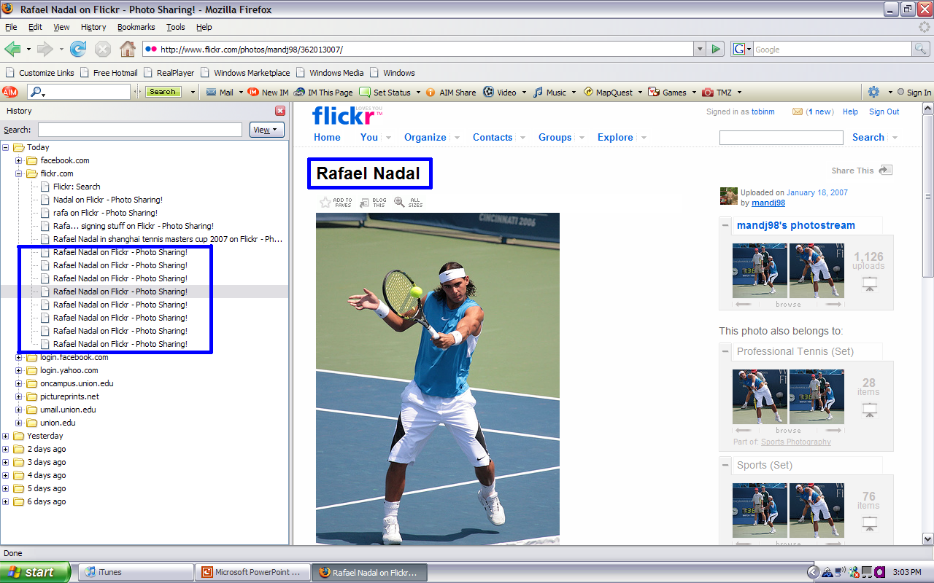
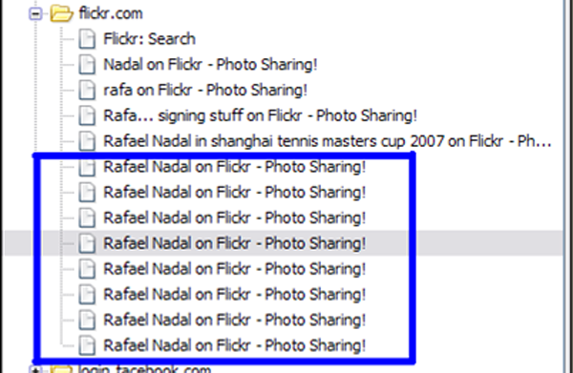
Title of page uses name of picture

Slide 5
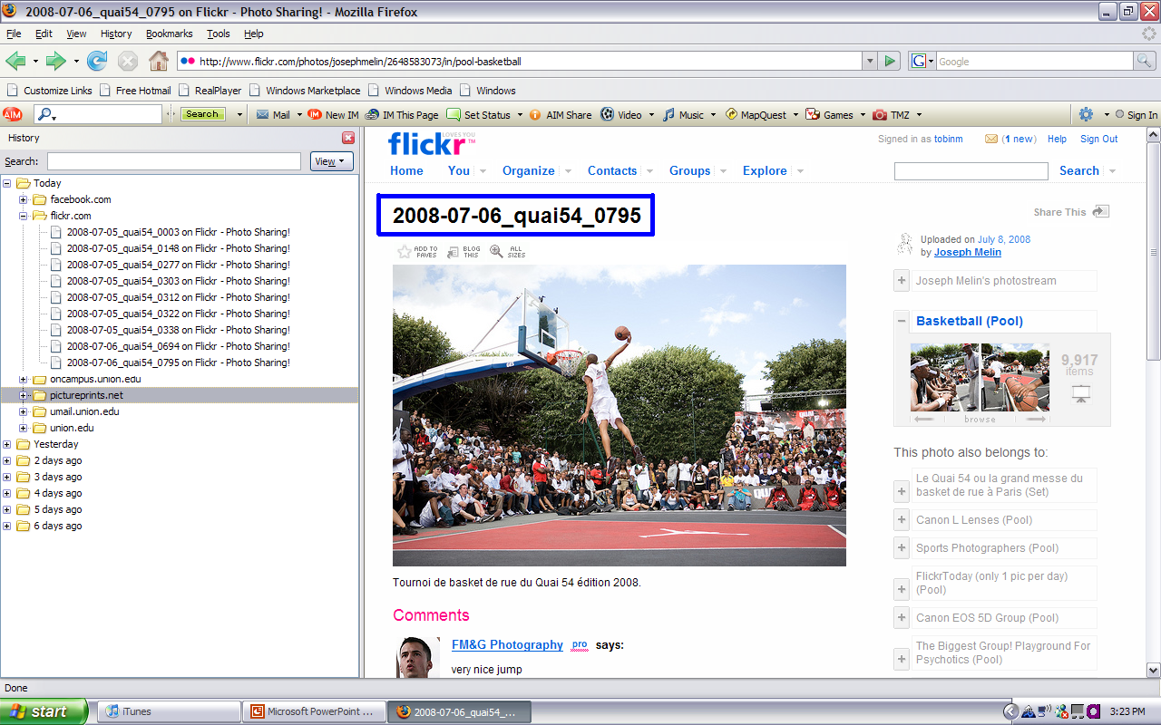
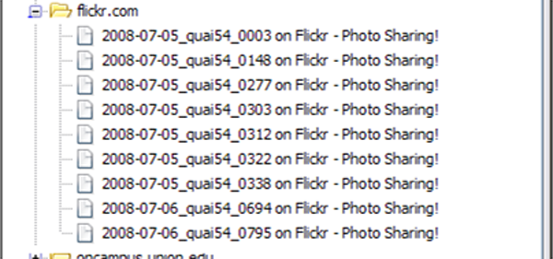
Title of page uses picture ID

Slide 6
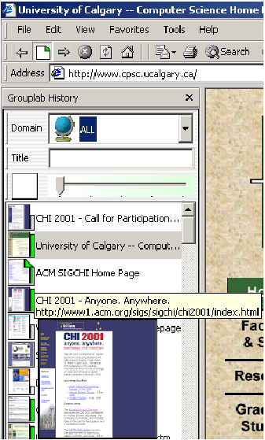
Shaun Kaaston and Saul Greenburg (2001)

Slide 7
Research Question
When finding a previously viewed picture, what does the user think of first:
What album did the picture come from?
How recently was the picture viewed?

Slide 8
Evaluation
Digit Recall
Navigation
Task
Retrieval
Task
Recency
Condition
Album
Condition

Slide 9
Navigation Task

Slide 10
Retrieval Task
2 photo albums of all the pictures they viewed in Navigation Task
sorted by recency
sorted by album

Slide 11
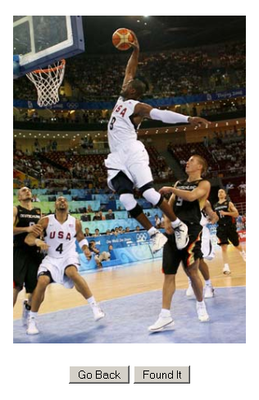
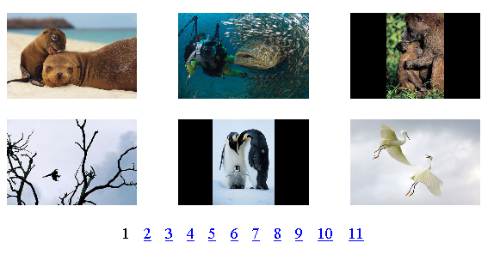
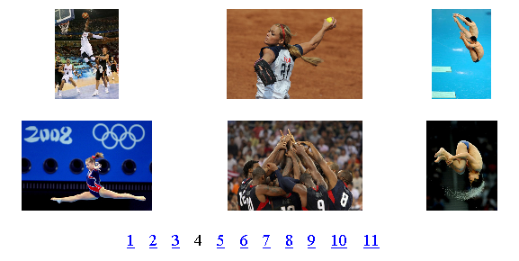
Recency: Does the user first think of when the picture was viewed?

Slide 12
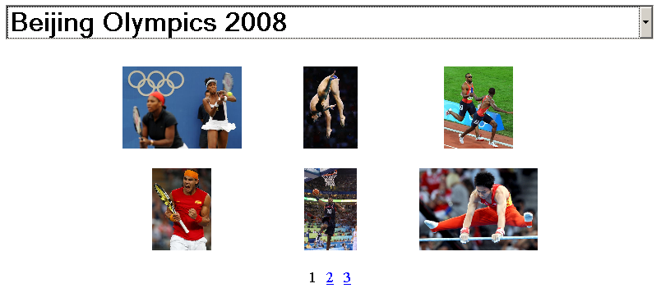
Album: Does the user first think of what album the picture was in?

Slide 13
2x2 Mixed Factors Design
Total Participants
Recency Condition
Album Condition
Digit Recall
Digit Recall
Album Condition
Recency Condition

Slide 14
Estimated Time

Slide 15
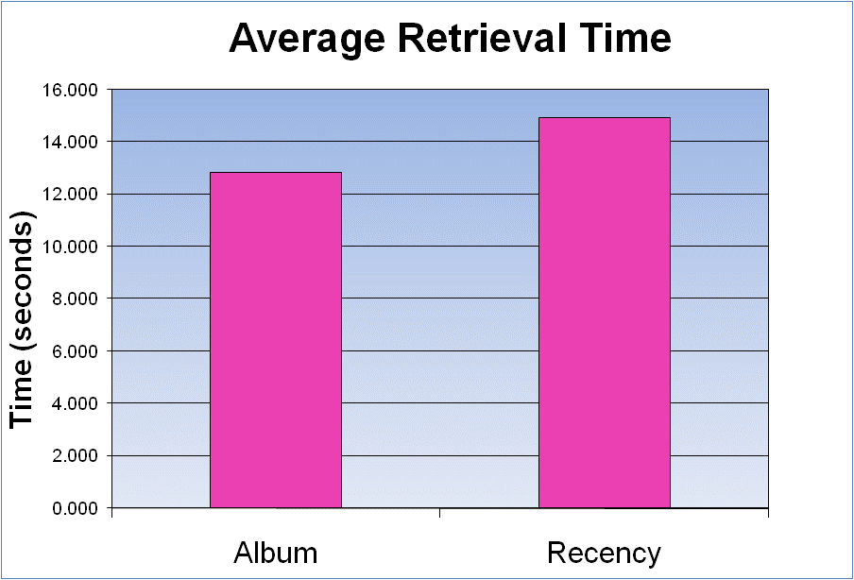
Results

Slide 16
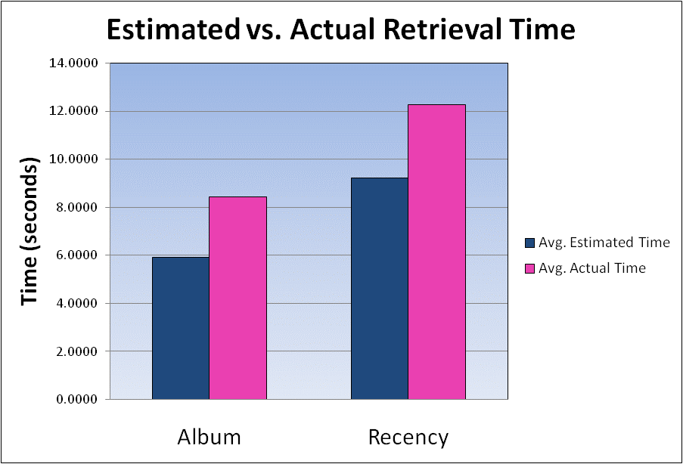
Results (cont’d)
Notes:
Do average of differences instead of difference of averages
Combine all pictures instead of separing pic 5, 10, 15 and do bar graph

Slide 17
Future Work
Improve future history list designs for more natural mapping
Collapse results of current history lists
How does a user think when searching for a general page in the history list?
In what situations may a user think in one way over another?
Separate a user’s photo history from the history list

